Slide 1
Topology of Flight Paths
Tobias Soltvedt

Slide 2
The Task:
Use Topological data analysis (TDA) on flight traffic data:
How will I get the data?
What does the data look like?
What is TDA?
What can I use TDA for?

Slide 3
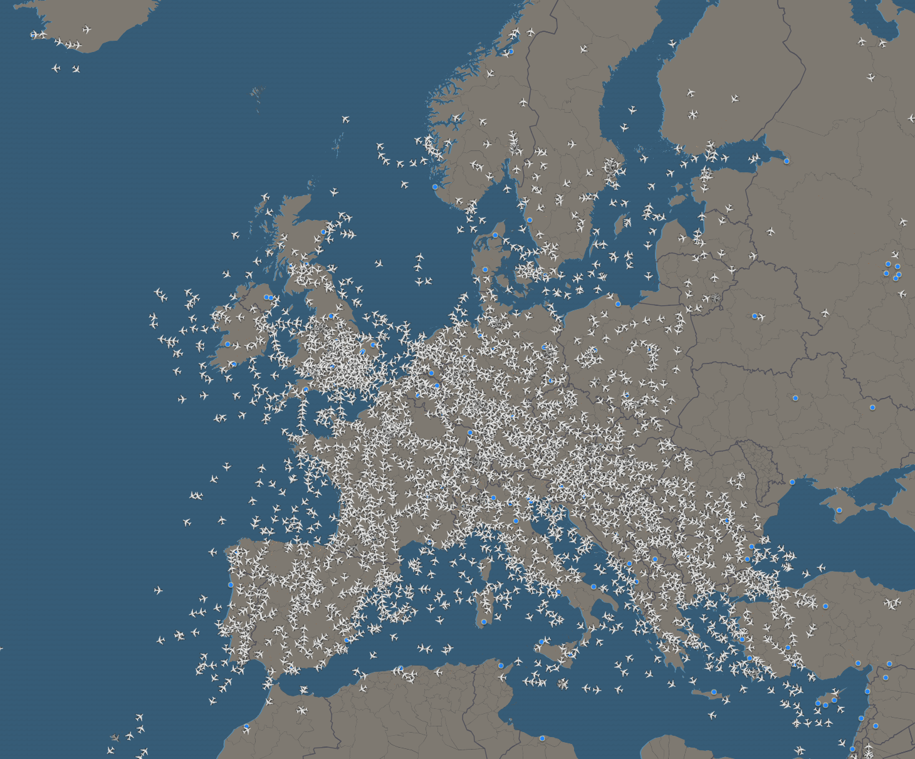
The Dataset
Opensky Network
Has large crowd sourced database
Python library to query the database for flights
Python library to visualize and query flights

Slide 4
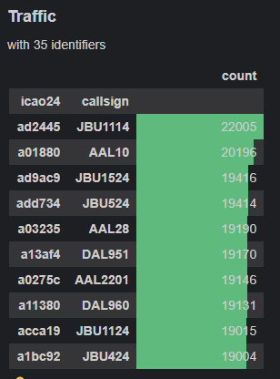
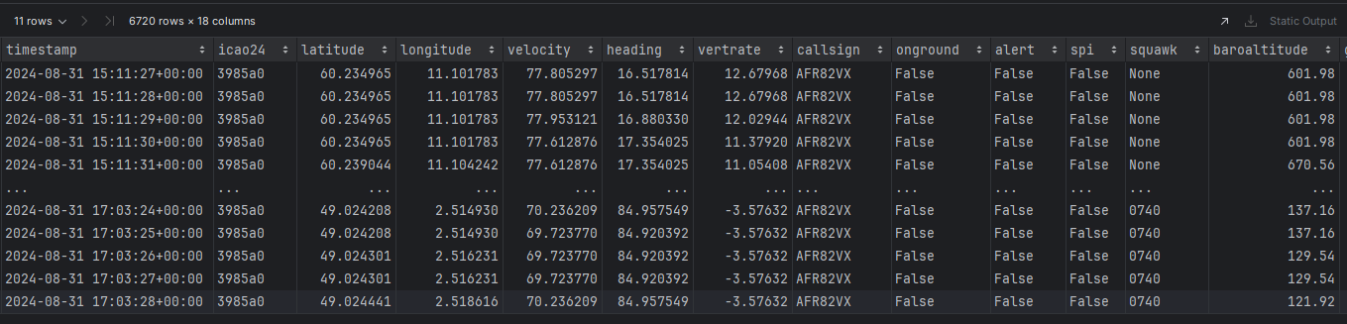
What does the data look like?
2 main objects:
Traffic holds data about many flights
Flight holds data about a single flight

Slide 5
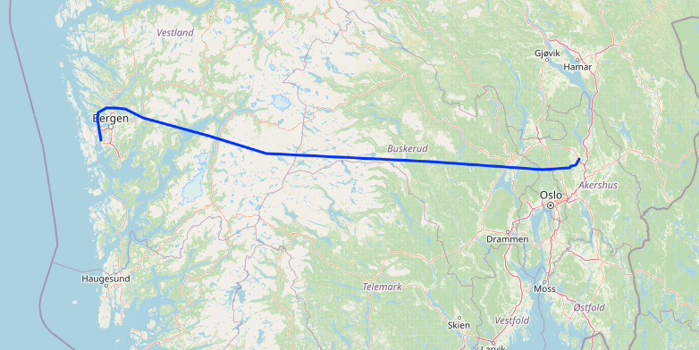
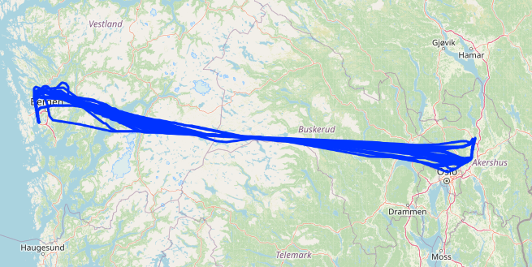
What does the data look like?
A flight from Gardemoen to Flesland the 29th of August
All the flights from Gardermoen to Flesland during the 29th of August

Slide 6
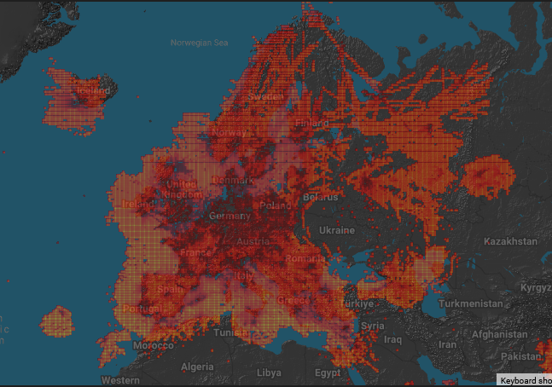
Potential issues with the data:
Collected by airplane radio sensors
Missing data
Coverage map
Conclusion:
Probably best to focus on flights within Europe and the USA

Slide 7
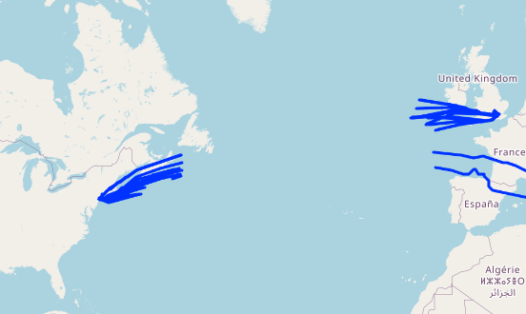
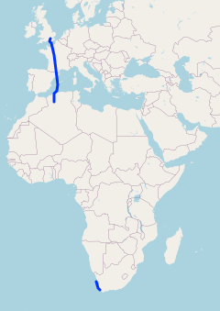
Potential issues with the data:
Missing data over the Atlantic ocean
Missing data over most of Africa

Slide 8
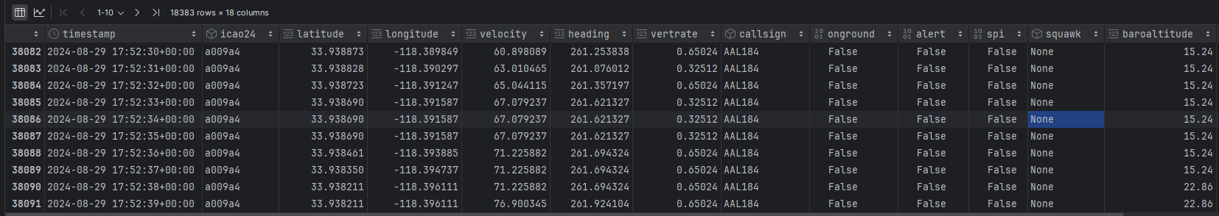
Potential issues with the data:
There is a lot of data
TDA is not the most efficient
18 300 rows for a single flight

Slide 9
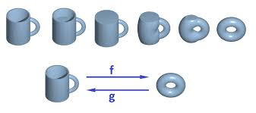
What is Topological data analysis? (TDA)
Related to Geometry
Focuses on shape instead of distances
Deformation is Topologically equivalent

Slide 10
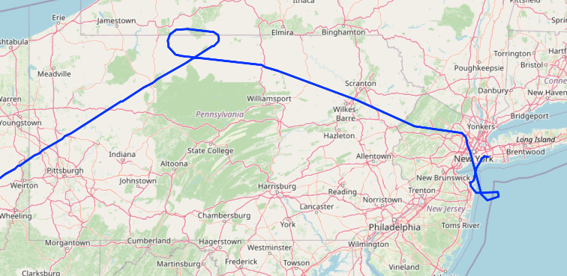
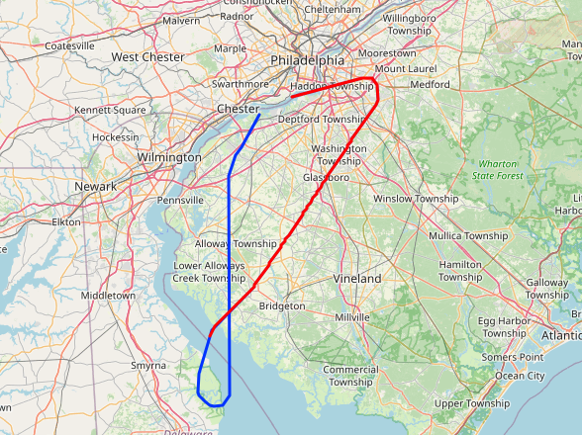
Goal:
Task is quite open
Goal is uncertain
Potential usages could be to predict if:
There has been an emergency
An airport is busy

